Slide 1
Chapter 7: Delivering the digital customer experience

Slide 2
Learning objectives
Describe the different stages and processes needed to create an effective website, mobile app or social media presence and to optimize its performance
Define the success factors that contribute to an effective digital experience delivered as a website, mobile app, or where relevant, in-store, virtual, or augmented reality

Slide 3
Chapter content
Overview of digital customer experience
Planning website, app design, and redesign projects
Initiation of a digital experience project
Defining site or app requirements
Designing the information architecture
Designing the user experience
Online retail merchandising
Evaluating the impact of service quality on e-loyalty

Slide 4
Digital customer experience
Definition:
A brand’s total digital experience includes a brand’s presence on different platforms including desktop website, mobile site and apps, ads on gaming platforms and digital in-store.
The quality of digital experience is based on the combination of rational and emotional factors of using a company’s online services that influences customers’ perceptions of a brand online.
Notes:
Figure 7.2 The online customer experience pyramid – success factors

Slide 5
Creating effective digital experiences
Supporting both purposes simultaneously:
achieving marketing goals
deliver relevance and a satisfactory digital customer experience for its audience
➔ the online experience promised by a brand requires delivering rational values and emotional values for customers
Kim tự tháp các yếu tố ảnh hưởng đến trải nghiệm trực tuyến của KH
Source: Based on de Chernatony (2001)

Slide 6
Planning website, app design and redesign projects
Purpose:
Web/app should be at the heart of online presence and communications which evitably affects customer experience → requires a structured plan and careful design.
The planning process for any digital experience:
Pre-development tasks
Discovery, analysis and design
Content creation, coding or development and testing
Publishing or launching the site or improvement.
Pre-launch promotion or communications
Ongoing promotion.
Ongoing development
Notes:
Pre-development tasks. For a new site or app, these include domain name registration and deciding on the company to host the website. They also include preparing a brief that sets out the aims and objectives of the site, and then – if it is intended to outsource the site – presenting the brief to rival agencies to bid for and pitch their offering.
Discovery, analysis and design. This is a research phase involving detailed analysis and design of the site, and includes clarification of business objectives, market research to identify the audience and typical customer personas and user journeys and their needs, defining the information architecture of different content types and prototyping different functional and visual designs to support the brand.
Content creation, coding or development and testing. Developing the site to create pro- totypes including integration of content management systems, database integration, usability and performance testing. Publishing or launching the site or improvement. This is a relatively short stage, involving releases of different versions of an application or website update. Often a soft launch is used, where the site is updated but the version is not widely communicated until the owners are sure the site is stable. Some site owners test features with a limited number of users to assess their impact before the features are rolled out more widely. Pre-launch promotion or communications. Search engine registration and optimisation is most important for new sites. Although search engines can readily index a new site, they don’t give the same level of visibility to new sites (sometimes known as ‘the Google sandbox effect’), where the site is effectively on trial until it is established with links from other sites indicating its credibility. Briefing the PR company to publicise the launch is another example of pre-launch promotion.
6 Ongoing promotion. The schedule should also allow for promotion after site launch. This might involve structured discount promotions on the site, or competitions that are planned in advance. Many now consider search engine optimisation, content marketing and pay-per-click marketing (Chapter 9) as a continuous, ‘always-on’ process, and will often employ a third party to help achieve this.
7 Ongoing development. It used to be commonplace for there to be a time gap of several years between major website redesigns involving new layout and typography. Although content relating to products, services and promotions would be updated, the layout of page templates remained static. Increased adoption of CRO, which we described at the start of the chapter, means that the process of tasks 1 to 5 is repeated between major updates using an agile development process, as explored further in the next section.
Các nhiệm vụ trước khi phát triển dự án:
đăng ký tên miền, lựa chọn host
Chuẩn bị bản tóm tắt để trình bày với host và các bên liên quan: nêu các mục tiêu và mong muốn của DN
Khám phá, phân tích và thiết kế:
Xác định các mục tiêu kinh doanh mà web cần đạt được
Xây dựng chân dung đặc điểm của người dùng điển hình, hành trình và nhu cầu của họ
Xác định kiến trúc thông tin và các loại nội dung
Thiết kế nguyên mẫu
Sáng tạo nội dung, phát triển và thử nghiệm
Có tích hợp với các hệ thống quản trị nội dung, hợp nhất với cơ sở dữ liệu và thử nghiệm
Các hoạt động truyền thông về web trước khi giới thiệu chính thức:
thử nghiệm SEO,
mức độ hiển thị,
làm việc với các cty truyền thông hay báo giới…
Các hoạt động truyền thông sau khi giới thiệu:
SEO, SEM (trả tiền)
Thuê bên thứ ba truyền thông…
Phát triển liên tục:
Cập nhật nội dung
Thay đổi cấu trúc
Tối ưu CRO

Slide 7
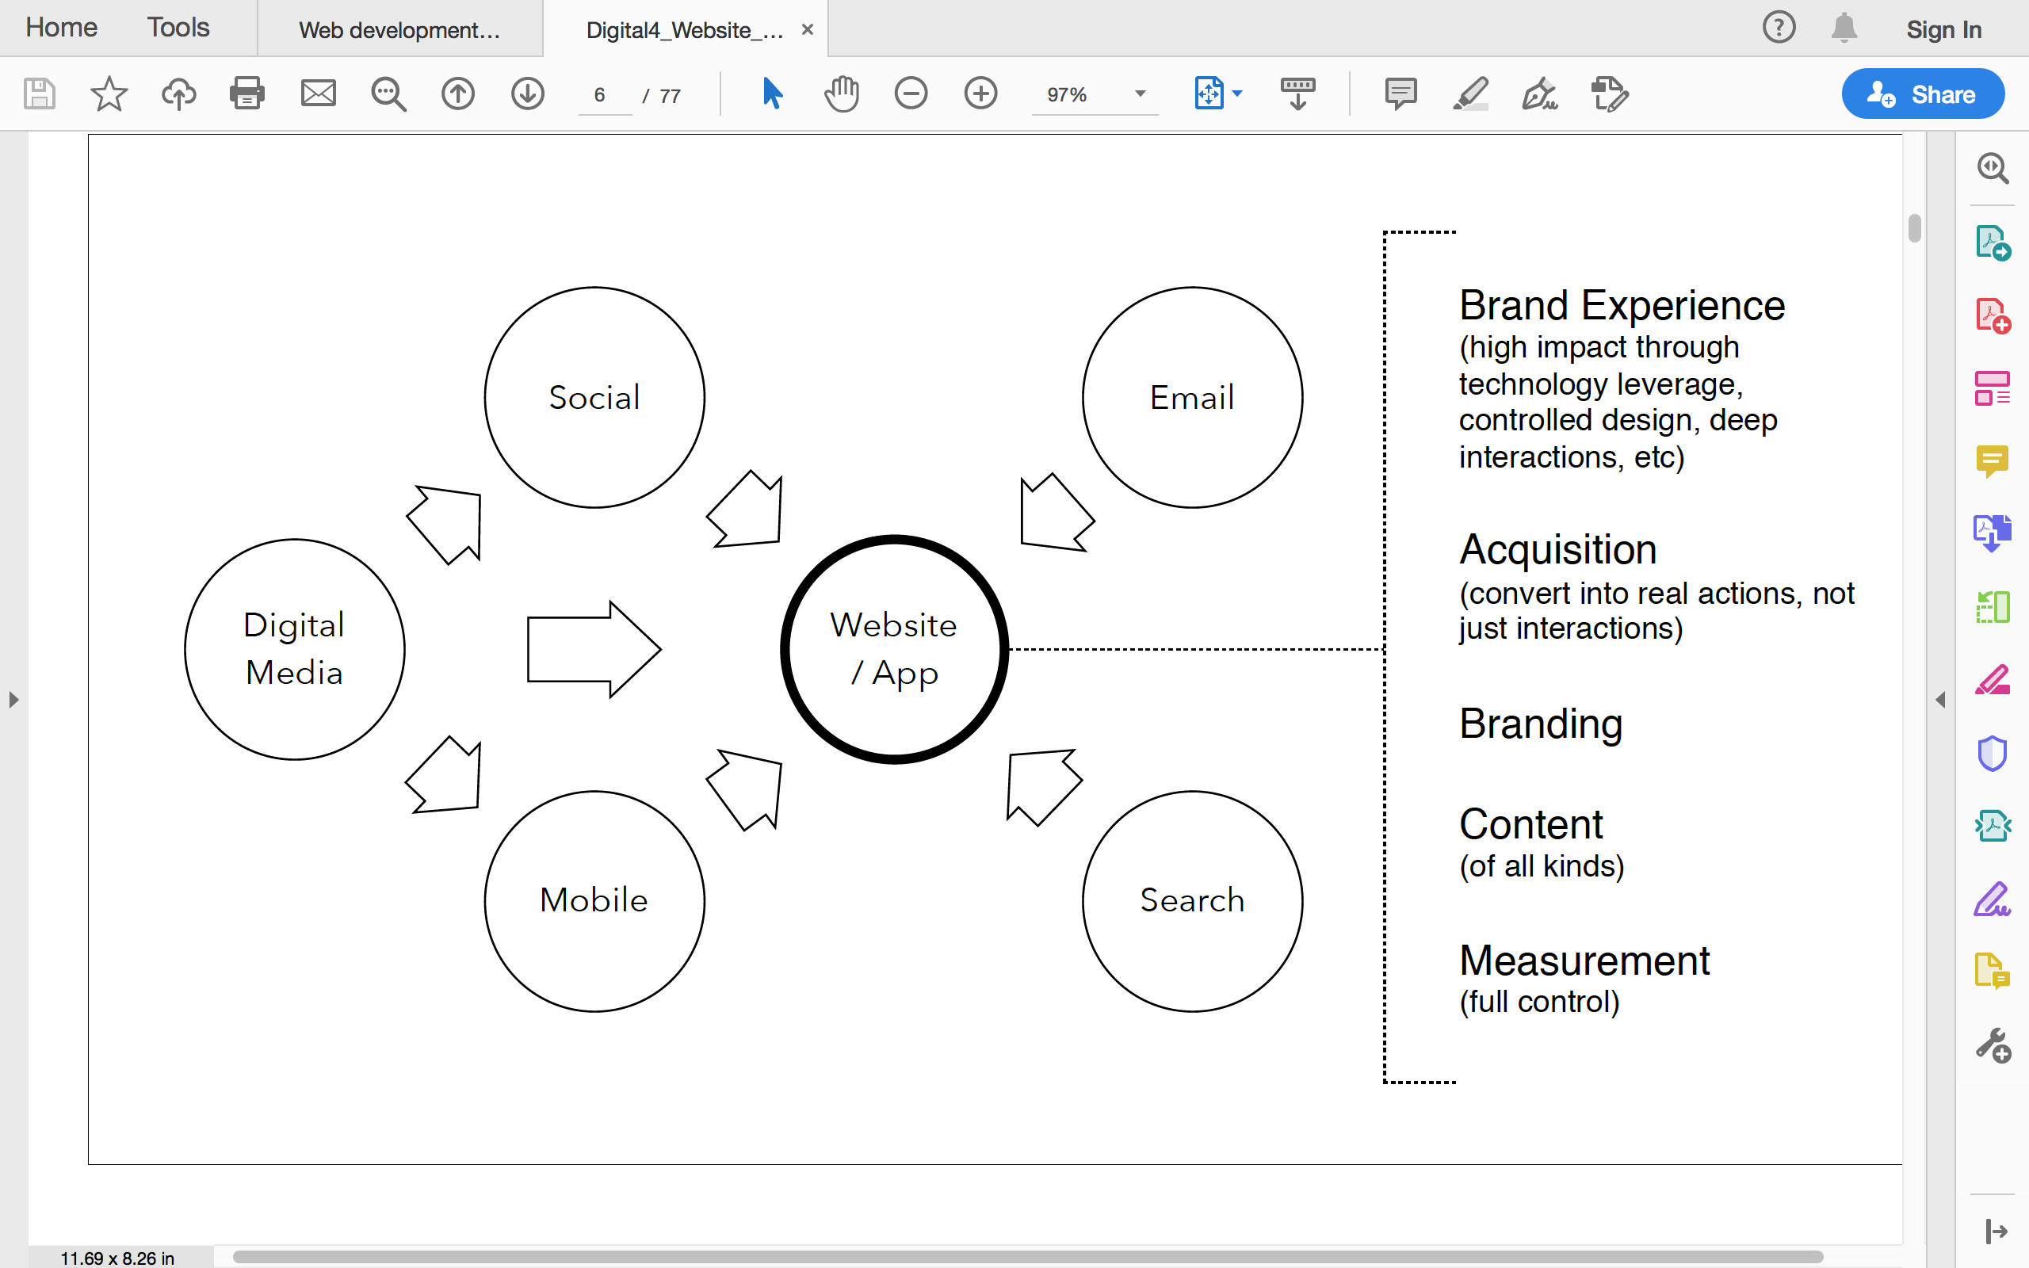
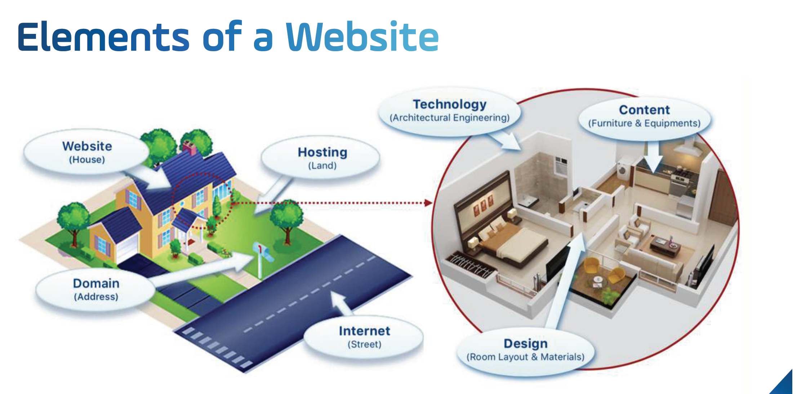
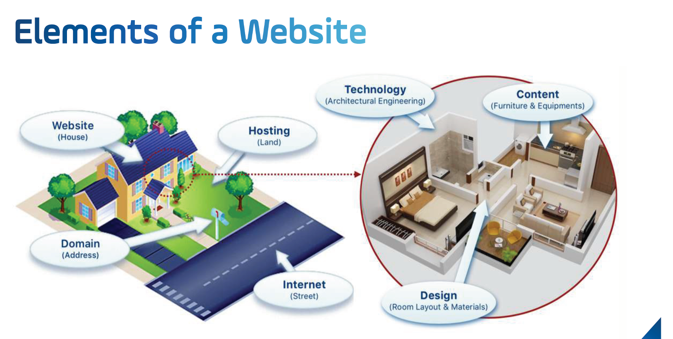
Website
“The central core of Owned Media as well as Digital Marketing”
— Nivea’s Global Head of DigiMarket

Slide 8
Figure 7.3 Summary of the process of website development

Slide 9
Figure 7.4 Interactive approach to improving site effectiveness
Source: Sullivan (2011)

Slide 10
Who should be involved in a digital experience project?
Site sponsors.
Site owner
Project manager
Site designer
Content developer
Web developer and webmaster.
Digital experience analyst or CRO expert.
Stakeholders: marketing, product and brand managers
Notes:
Site sponsors. These will be senior managers who will effectively be paying for the system from their budgets. They will understand the strategic benefits of the system and will be keen that the site is implemented successfully to achieve the business objectives they have set.
Site owner. ‘Ownership’ will typically be the responsibility of a marketing manager or e-commerce manager who may be devoted full-time to overseeing the site in a large company or it may be part of a marketing manager’s remit in a smaller company. Project manager. This person is responsible for the planning and coordination of the website project. They will aim to ensure that the site is developed within the budget and time constraints that have been agreed at the start of the project, and that the site delivers the planned-for benefits for the company and its customers. Site designer. The site designer will define the ‘look and feel’ of the site, including its styling through cascading style sheets (CSS), layout and how company brand values are transferred to the web. Content developer. The content developer will write the copy for the website and convert it to a form suitable for the site. In medium or large companies this role may be split
between marketing staff or staff from elsewhere in the organisation who write the copy. Web developer and webmaster. These are technical roles. The web developer implements the site design using the application development language used for delivering the content. The webmaster is responsible for ensuring the quality of the site. This means achieving suitable availability, speed, working links between pages and connections to company databases. In small companies these roles may also take on graphic design and content developer roles.
Digital experience analyst or CRO expert. Familiar with business needs and customer journey, and can also analyse digital analytics to identify site effectiveness and how to run conversion rate optimisation experiments (as explained further in Chapter 10).
Stakeholders. The impact of the website on other members of the organisation such as marketing, product and brand managers should not be underestimated since they will also be involved with content updates.

Slide 11
Figure 7.5 Example of a website ‘Design and Build’ project timeline

Slide 12
Initiation of a digital experience project
Purpose: review the aims and objectives of the website, assess whether it is worthwhile investing in the website , and to decide on the amount to invest
Main tasks:
Domain name registration
Selecting a hosting provider
Website performance optimisation
The availability of the website

Slide 13
Figure 7.7 Web Page performance test service results (www.webpagetest.org )

Slide 14
Defining site or app requirements
Purpose: involves using different marketing research techniques to find out the needs of the business and audience, whether it’s a website, mobile site, app or company social page → to identify requirements for user–centred design alongside with marketing–led site design.
Notes:
Phân tích các mục tiêu marketing cần đạt được :
Thu hút khách hàng bằng những đề xuất giá trị rõ ràng
Chuyển đổi khách hàng: thực hiện hành động, duy trì sự chú ý…
Duy trì và giữ chân khách hàng
Chất lượng dịch vụ của website
Tương tác với thương hiệu
Who are the key audiences for the site or app?
In which context, i.e. when, where and on which devices, is the experience primarily • accessed: at home, at work or while mobile? • Why should they use the site or app (what will appeal to them)? • What should the content be? Which services will be provided (value proposition)? • How will the content be structured and labelled (information architecture)? • How will navigation occur (findability)?
What are the ‘top tasks’ that users will want to complete? What will the main ‘customer journeys’ be?
What are the main marketing outcomes we want the experience to deliver, such as regis-
tration, leads and sales, and how will we increase them (persuasion and CRO)?
Customer acquisition. The online value proposition must be clear. Appropriate incentives for customer acquisition and permission marketing such as those described in Chapter 6
must be devised. Customer conversion. The site must engage first-time visitors. Call to action for customer acquisition, lead generation and retention offers must be prominent, with benefits clearly explained. The fulfilment of the offer or purchase must be as simple as possible to avoid
attrition during this process. Customer retention. Appropriate incentives, content and customer service information
to encourage repeat visits and business must be available (see Chapter 6). Service quality. This has been covered in this chapter. Service quality is affected by site
navigation, performance, availability and responsiveness to enquiries. Branding. The brand offer must be clearly explained and interaction with the brand must be possible.

Slide 15
Defining site or app requirements (cont.)
Analysis phase:
User analysis: who, which, why, how, what?
Business requirements: Customer acquisition, customer conversion, Customer retention, Service quality, Branding
Usability requirements: expert review, user testing
Digital accessibility requirements
Personalisation
Localization and cultural customisation
Reviewing competitors’ websites
Notes:
Business requirements
With a focus on user-centred design, there is a risk that business requirements to achieve marketing outcomes may be marginalised. A marketing-led site design is informed by marketing objectives and tactics. A common approach is to base the design on achieving the performance drivers of successful digital marketing (referred to in Chapter 4) and the loyalty drivers referred to at the start of this chapter. Design will be led by the following performance drivers:
Customer acquisition. The online value proposition must be clear. Appropriate incentives for customer acquisition and permission marketing such as those described in Chapter 6
must be devised. Customer conversion. The site must engage first-time visitors. Call to action for customer acquisition, lead generation and retention offers must be prominent, with benefits clearly explained. The fulfilment of the offer or purchase must be as simple as possible to avoid
attrition during this process. Customer retention. Appropriate incentives, content and customer service information
to encourage repeat visits and business must be available (see Chapter 6). Service quality. This has been covered in this chapter. Service quality is affected by site
navigation, performance, availability and responsiveness to enquiries. Branding. The brand offer must be clearly explained and interaction with the brand must be possible.
Digital accessibility
An approach to website, app and digital device design intended to accommodate universal usability including that required by the visually impaired and users with other disabilities, including motor control, learning difficulties and deaf
users. Users whose first language is not English can also be assisted.

Slide 16
Figure 7.10 Personalisation pyramid web site
Source: Monetate, with permission.
Notes:
Personalisation
Digital experience personalisation is the dynamic serving of customised content, product or promotional offer recommendations to website visitors or app users based on their characteristics and intent behaviour to support conversion and long-term engagement goals.
1 Optimisation using AB testing. This technique is used as part of conversion-rate opti- misation to identify which page elements and variations are important to increasing conversion. It isn’t typically personalisation based on data collected, but involves serving different content to some groups of users compared to a control.
2 Segmentation using rules-based targeting. Here rules are set up in a personalisation system to serve different content to different audience groups based on the four types of implicit data mentioned previously. For example, first-time visitors can be served a different message to repeat visitors, or a ‘next-best product’ can be recommended to a previous purchaser.
3 1:1 Personalisation. This approach goes beyond predefined rules to use machine learn- ing or predictive analytics to serve the most relevant messages to an individual, based on all the known profile information and how others similar in their characteristics have responded in the past.
Localisation
Tailoring of website information for individual countries or regions. Localisation can include simple translation, but also cultural adaptation.
Reviewing competitors’ websites
Benchmarking of competitors’ websites is useful to position a website to compete effectively with its rivals. Given the importance of this activity, criteria for performing benchmarking have been described in Chapters 2 and 4.
Information architecture
Site map
A graphical or text depiction of the relationship between different groups of content on a website.
Findability
An assessment of how easy it is for a web user to locate a single content object or to use browse navigation and search system to find content. Like usability
it is assessed through efficiency – how long it takes to find the content, and effectiveness – how satisfied the user is with the experience and relevance of the content they find.

Slide 17
Figure 7.11 The continuum of translation types
Source: Chaffey (2017)

Slide 18
Designing the information architecture
Purpose: The combination of organization, labelling, and navigation schemes constituting an information system.
Benefits:
A defined structure and categorisation of information will support user and organisation goals, i.e. it is a vital aspect of usability.
It helps increase ‘flow’ on the site – a user’s mental model of where to find content should mirror that of the content on the website.
Search engine optimization – a higher listing in the search rankings can often be used through organizing and labeling information in a structured way.
Applicable for integrating offline communications – offline communications such as ads or direct mail can link to a product or campaign landing page to help achieve direct response, sometimes known as ‘web response’.
Related content can be grouped to measure the effectiveness of a website as part of design for analysis.

Slide 19
Figure 7.12 Site structure diagram (blueprint) showing layout and relationships between pages

Slide 20
Figure 7.13 Example wireframe for a children’s toy site

Slide 21
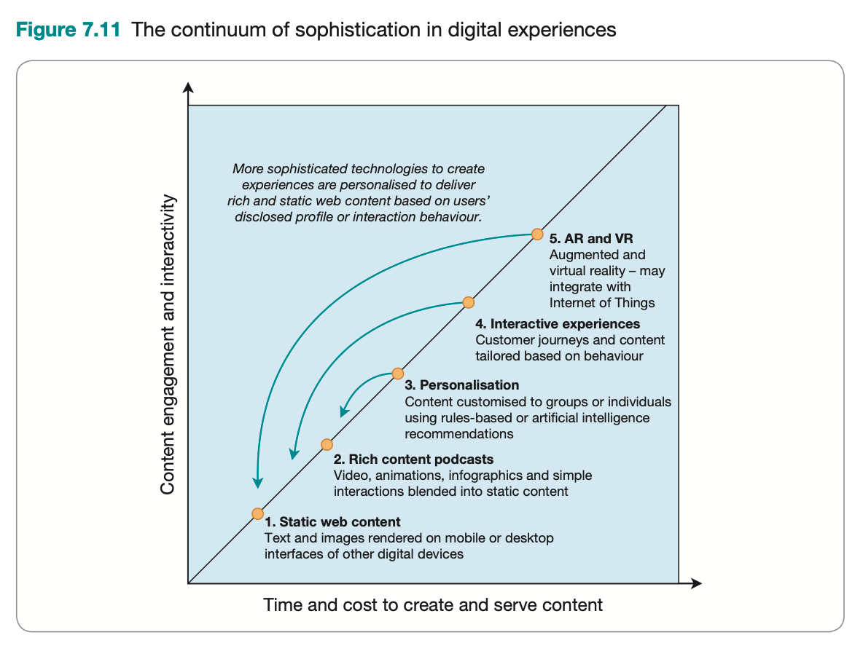
Designing the user experience
User-centered design: Design based on optimising the user experience according to all factors, including the user interface.
Elements of digital experience design
Site design and structure – the overall structure of the site.
Page design – the layout of individual pages.
Content design – how the text and graphic content on each page is designed.
Site navigation schemes
Other elements:
Mobile design requirements and techniques
Internet of things - IoT
Virtual reality and augmented reality
Notes:
Figure 7.14 Responsive design showing updated layout for different content blocks

Slide 22
Figure 7.16 Variation between product complexity, customer value and type of online experiences used to deliver service
Notes:
Sự khác biệt giữa độ phức tạp của sản phẩm, giá trị khách hàng và loại trải nghiệm trực tuyến được sử dụng để cung cấp dịch vụ: SP càng phức tạp và càng cần cung cấp nhiều giá trị KH thì trải nghiệm kh trực tuyến cũng phải tăng theo

Slide 23
Content design and managing
Content marketing: The management of text, rich media, audio and video content aimed at engaging customers and prospects to meet business goals published through print and digital media including web and mobile platforms, which is repurposed and syndicated to different forms of web presence such as publisher sites, blogs, social media and comparison sites.
Main tasks:
Content mapping: Different content types and formats are reviewed for their potential for engaging target audiences through the customer lifecycle. (RACE or TOFU_MOFU_BOFU):
Content audit: A structured review of the effectiveness of different content types and formats to meet the needs of users and the business, using quantitative and qualitative techniques.
Managing and testing content
Notes:
Phân tích các mục tiêu marketing cần đạt được :
Thu hút khách hàng bằng những đề xuất giá trị rõ ràng
Chuyển đổi khách hàng: thực hiện hành động, duy trì sự chú ý…
Duy trì và giữ chân khách hàng
Chất lượng dịch vụ của website
Tương tác với thương hiệu

Slide 24
Notes:
Podcast là sự kết hợp giữa “iPod” và “broadcasting”, mặc dù không cần thiết phải sở hữu một chiếc iPod để nghe những chương trình phát thanh truyền hình. Thuật ngữ này có thể được sử dụng trong nhiều cách khác nhau, nhưng thông thường tạo Podcast liên quan tới việc công bố các audio hay file video trên mạng Internet. Các file này thường được gọi là “podcast” hay “show” và tương tự như những chương trình phát thanh trên radio hay các chương trình truyền hình quần chúng. Những người tạo ra podcast gọi là podcaster.

Slide 27
Notes:
30% vỏ não xử lý hình ảnh; 8% cảm giác, 3% nghe

Slide 28
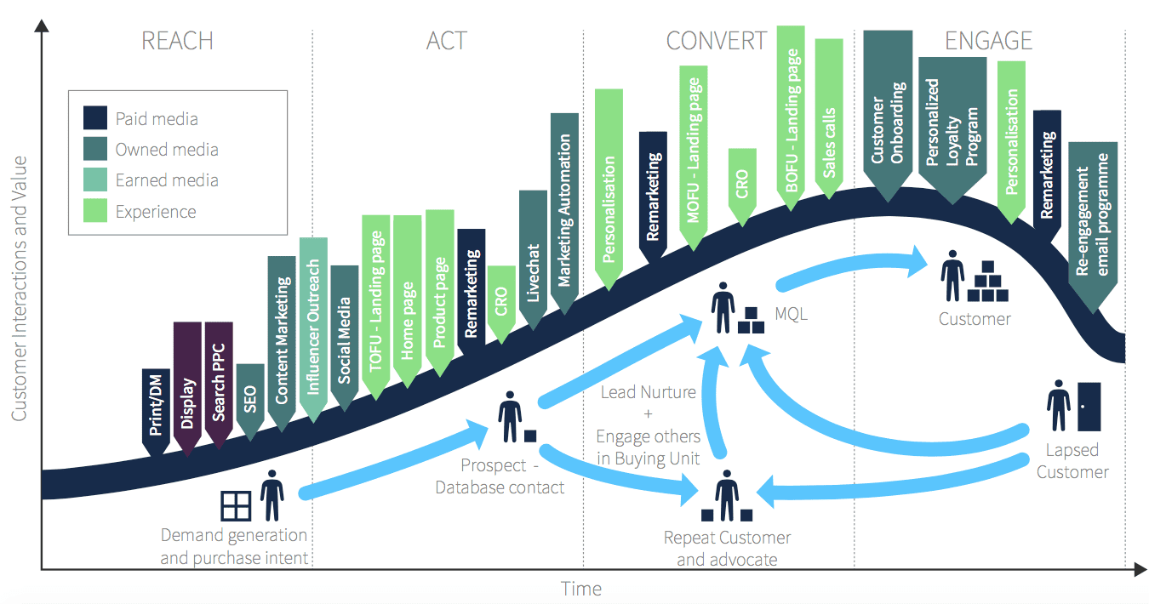
(Smart Insights, n.d.)
Notes:
https://nef.vn/cro-la-gi/
Để tối ưu hóa tỉ lệ chuyển đổi traffic thành khách hàng tiềm năng. Thứ chúng ta cần quan tâm là các yếu tố chính của CRO và cách sử dụng chúng hiệu quả (quy trình CRO)
Các yếu tố chính của CRO là gì?
CRO được tạo thành từ bốn yếu tố chính :
Nghiên cứu chuyển đổi
Trải nghiệm người dùng (UX)
Tính thuyết phục của trang web
Thử nghiệm A / B và cá nhân hóa.
Marketing automation is software that handles routine marketing tasks without the need for human action. Common marketing automation workflows include email marketing, behavioral targeting, lead prioritization, and personalized advertising.
https://www.navee.asia/kb/marketing-automation-la-gi-nhung-dieu-can-biet-ve-marketing-automation/
Marketing automation uses software to automate monotonous marketing work. Marketing departments can automate repetitive tasks such as email marketing, social media posting, and even ad campaigns - not just for the sake of efficiency, but also to provide a more personalized experience for their customers. The technology behind marketing automation makes these tasks faster and easier to do.
Marketing Qualified Lead còn được gọi là Warm Lead, là những khách hàng tiềm năng thuộc giai đoạn giữa của phễu Marketing. Những lead thể hiện sự quan tâm cũng như sự tương tác nhất định tới sản phẩm – dịch vụ – thương hiệu của doanh nghiệp.
https://peoplepulse.com/resources/useful-articles/lapsed-customers/
Key finding #1 – Many organisations have no idea how many customers they are losing each year … and it is probably more than they realise:
Close to 50% of Marketing Managers and 30% of Sales Managers could not identify their company’s percentage of annual customer loss. Those who thought they knew their firm’s defection rates believed that it averaged about 7-8% per year. However research shows that the average firm loses between 20 to 40% of its customers per year.
Source: Customer Winback: How to Recapture Lost Customers – And Keep Them Loyal By Jill Griffin & Michael W. Lowenstein, February, 2001
What is your annual percentage of customer loss? If it was between 20% to 40% of your customer base, as the research suggests, what would this be doing to your bottom line?
The average firm loses between 20 to 40% of its customers per year. CLICK TO TWEET
Key finding #2 – Lapsed customers make for better prospects:
All is not lost. If your percentage customer loss is higher than you’d like don’t despair. A study by Marketing Metrics has found firms have a much better chance of winning business from lost customers than from new prospects. The research found the average firm has a 20 to 40 percent probability of successfully selling to lost customers, and only a 5 to 20 percent probability of making a successful sale to brand new prospects. Bottom line – customer win back can bring big rewards. The important thing here is to understand why your customers left in the first place. Armed with this information in many cases you can rectify the problem and win them back.
Source: Jill Griffin– The Loyalty Maker 2009 – 2011 (http://www.loyaltysolutions.com/winback-faq/)
Key finding #3 – The majority (96%) of Customers won’t tell you why they stopped buying … unless you ask:
https://marketinginsidergroup.com/content-marketing/what-is-smart-content-and-how-can-it-work-for-you/
“Smart” content is just another name for dynamic content. If that term sounds more familiar to you, it’s probably because you’re aware that there are “static” websites and “dynamic” websites.
Static websites are hard-coded and display exactly the same information to all viewers at all times. Dynamic websites pull their content from a database and construct webpages on the fly, meaning that the data displayed can change to suit the viewer.
In fact, the vast majority of websites these days are dynamic. There are not so many static websites around. This is because they’re both more powerful and more flexible. As the data is stored in a database and completely separate from the visual design, it’s very easy to update the look of the site. The content isn’t all mixed in with the display code.

Slide 29
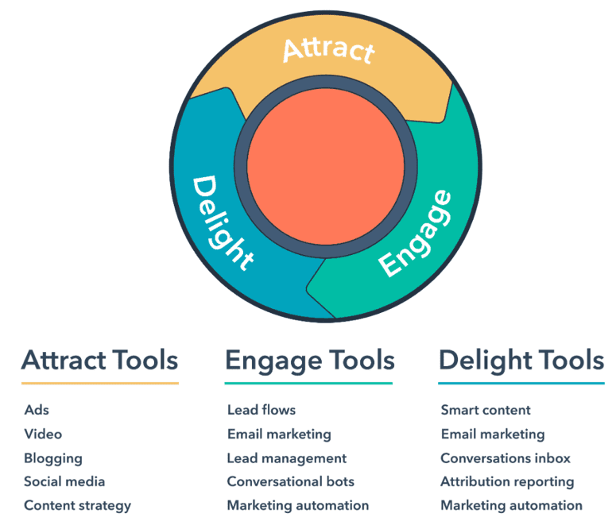
Effective Content Marketing
(Llewellyn, 2020)
Notes:
Content marketing strategy is essential for success
Conversational bots: chatbot
Marketing automation: deliver right content to right people at the right time
https://knowledge.hubspot.com/website-pages/create-and-manage-smart-content-rules

Slide 30

Effective Content Strategy (Kingsnorth, 2019)
To build an effective content strategy you need to understand how to:
measure the value of content
distribute content effectively.
use different types of content
use content in an international business
Notes:
To build an effective content strategy you need to understand how to:
measure the value of content
distribute content effectively.
use different types of content
use content in an international business

Slide 31
Content Marketing Strategy Framework
Framework element | What this means
Purpose and goals | Why you are creating content and what value it will provide?
Audience | For whom are you creating content and how will they benefit?
Story | What specific, unique, and valuable ideas will you build your content assets around?
Process | How will you structure and manage your operations to activate your plans?
Measurement | How will you gauge performance and continually optimize your efforts?
(Content Marketing Institute, 2017)
Notes:
Why you are creating content and what value it will provide?
For whom are you creating content and how will they benefit?
What specific, unique, and valuable ideas will you build your content assets around?
How will you structure and manage your operations to activate your plans?
How will you gauge performance and continually optimize your efforts?

Slide 32
Content Management Process
Themes for the year
Content calendar
Content guidelines
Content creation and editing
Publish or schedule
Distribute and promote
Review
(Hanlon, 2019)

Slide 33
High Quality Content Marketing
Credible – your audience has to believe the content
Shareable – ask ‘Will my audience want to share this?’
Useful or fun – ask ‘Does it pass the ‘so what?’ test?’
Interesting – ask ‘Is it worth making a remark about?’
Relevant – it is crucial that your audience value the content
Timely – content is most effective in the right place at the right time
Different – ask ‘Has this been done before?’
On brand and authentic - Consumers expect to link content and brand.
(Kingsnorth, 2019)
Notes:
Credible – your audience has to believe the content
Shareable – ask ‘Will my audience want to share this?’
Useful or fun – ask ‘Does it pass the ‘so what?’ test?’
Interesting – ask ‘Is it worth making a remark about?’
Relevant – it is crucial that your audience value the content
Timely – content is most effective in the right place at the right time
Different – ask ‘Has this been done before?’
On brand and authentic - Consumers expect to link content and brand.

Slide 34
Online presence matrix – e.g
Nhóm kênh | Kênh | Tên kênh cụ thể | Mục tiêu xuất hiện | Công cụ marketing | Hình thức thông tin (nội dung)
Báo mạng | Tin tức xã hội tổng hợp | Vnexpress.net/ homepage | - Làm đối tượng A hiểu về thương hiệu | Quảng cáo | Banner cuốn dọc, tương tác
Website của DN |  |  | Chuyển đổi KH, Bán hàng, chăm sóc KH... | Chatbot, MKT automation tools, SEO, remarketing | Bài viết, hình ảnh, video, Tin nhắn và tin nhắn thoại, Q&A, FAQ…
Social Media | Social Sharings | Slide share | Educate KH về chức năng SP… | Xây dựng quan hệ khách hàng | White-papers hoặc ebooks
 | Social Network | Facebook | Tim kiếm KH mới Giải trí Tạo cảm hứng, gắn kết ... | Quảng cáo Sponsor Retargeting Chatbot, tin nhắn | Hình ảnh, web-link Game
Website của bên thứ ba | Website của các đối tác | Abc.com.vn | Thuyết phục KH ... | Co-branding | Text-link, chia sẻ nội dung (content sharing)
…

Slide 35
Online retail merchandising
Purpose: maximize the sales potential of an online store for each visitor.
Principles: connecting the right products with the right offer to the right visitor
Techniques:
Expanding navigation through synonyms.
Applying faceted navigation or search approaches
Featuring the best-selling products prominently.
Use of bundling
since this can reduce conversion rates.
Use of customer ratings and reviews
• 82 percent more page views per visitor.
Interactive product visualizers.
Notes:
Expanding navigation through synonyms. Through using a range of terms that may apply to the same product, the product may become easier to find if a site visitor is searching
using a particular expression. Applying faceted navigation or search approaches. Search results pages are important in online merchandising since conversion rates will be higher if relevant products and offers are at the top of the list. Faceted navigation enables website users to ‘drill down’ to easily select a relevant product by selecting different product attributes (Figure 7.14). Featuring the best-selling products prominently. Featuring strongest product lines promi- nently is a common approach, with retailers showing ‘Top 10’ or ‘Top 20’ products. Use of bundling. The classic retail approach of buy-one-get-one-free (BOGOF) is com- monly applied online through showcasing complementary products. For example, Ama- zon offers discounts on two or three related books, if bought together. Related products are also shown on the product page or in checkout, although care has to be taken here
• since this can reduce conversion rates. Use of customer ratings and reviews. Reviews can be important in influencing sales. Research from online ratings service BazaarvoiceTM showed that for one of its clients, CompUSATM, the use of reviews achieved: • 60 per cent higher conversion; • 50 per cent higher order value;
• • 82 per cent more page views per visitor. Interactive product visualisers. These systems enable web users to zoom in and rotate on products.

Slide 36
Evaluating the impact of service quality on e-loyalty
Models: WEBQUAL (Loiacono et al., 2000, 2007): 14 factors; E-SERVQUAL (Zeithaml et al., 2002): 7 factors
5 determinants of online service quality apply online.:
Tangibles
Reliability and responsiveness
Assurance: In an email or social media response context, assurance can best be considered as the quality of response.
Empathy
Tangibles | Reliability | Responsiveness | Assurance and empathy
Ease of use | Availability | Download speed | Contact with call centre
Content quality | Reliability | Email response | Personalisation
Price | Email replies | Call-back | Privacy
 |  | Fulfilment | Security
Notes:
WEBQUAL (Loiacono et al., 2000, 2007), which considers 14 dimensions. It has been criticised for relating too much to functional design issues rather than service issues. Con- sider other limitations, which could include rating of content or products, trust factors, support for different digital devices or integration with other online and offline channels. Green and Pearson (2011), for example, cover the trust factors and perceived risk. The dimensions of WEBQUAL are:
1 Information quality – the concern that information provided is accurate, updated and appropriate.
2 Functional fit to task – the extent to which users believe that the website meets their needs.
3 Tailored communications – communications can be tailored to meet the user’s needs.
4 Trust – secure communication and observance of information privacy.
5 Response time – the time it takes to get a response after a request or an interaction
with a website.
6 Ease of understanding – easy to read and understand.
7 Intuitive operations – easy to operate and navigate.
8 Visual appeal – the aesthetics of the site.
9 Innovativeness – the creativity and uniqueness of the website.
10 Emotional appeal – the emotional effect of using the website and intensity of involvement.
11 Consistent image – that the website does not create dissonance for the user by an image incompatible with that projected by the firm through other media.
12 Online completeness – allowing all or most necessary transactions to be completed online (for example, purchasing on the website).
13 Relative advantage – online service is equivalent to or better than other means of interacting with the company.
14 Customer service – the response to customer enquiries, comments and feedback when such response requires more than one interaction.
• E-SERVQUAL (Zeithaml et al., 2002) contains seven dimensions. The first four are classified as the core service scale, and the latter three dimensions are regarded as a recovery scale, since they are only relevant when online customers have questions or problems:
1 Efficiency refers to the ability of the customers to get to the website, search for information or transact as required.
2 Fulfilment involves the accuracy of service promises, including products’ in-stock availability and delivering the products in the promised time.
3 Reliability is associated with the technical functioning of the site, including avail- ability and performance.
4 Privacy is related to assurance that shopping behaviour data are not shared and that credit card information is secure.
5 Responsiveness refers to the ability of e-tailers to provide appropriate support information to customers when requested.
6 Compensation involves returns facilities for refunds, and return shipping and han- dling costs.
7 Contact is the ability of customers to talk to a live service agent online.

Slide 37
Chapter reference
Chaffey D. & Ellis-Chadwick F. (2022). Digital marketing - Strategy, Implementation and Practice (8th edition), chapter 7. Pearson. UK

Slide 38


